Slide 1



Slide 2
Aims objectives of the IAF
Founded in 2013 to
Provide authors’ organisations worldwide with an international platform to exchange information, develop positions and to provide support in authors’ rights matters
Advocate the author’s role in society, importance of creation for cultural diversity and the economic value authors create
Promote and defend authors’ interests and authors’ moral and economic rights
Work for balanced contractual legislation that guarantees fair practices for authors and ensures that authors retain their rights against buyouts and other unfair practices
Promote the benefits of authors’ rights in general and of collective management
Facilitate a strong authors’ presence in international organisations through lobbying and copyright awareness activities and through joint activities on areas of mutual interest.

Slide 3

Representing authors at the United Nations
The World Intellectual Property Organisation (WIPO) deals with copyright at an international level at it’s Standing Committee on Copyright and Related Rights (SCCRs) where discussions and agreements are made regarding international copyright issues and the international copyright framework.
The IAF holds permanent observer status at WIPO, speaking on behalf of authors at SCCRs to put their perspective to the committee members offering the expertise of the IAF to WIPO and UN delegates.

Slide 4
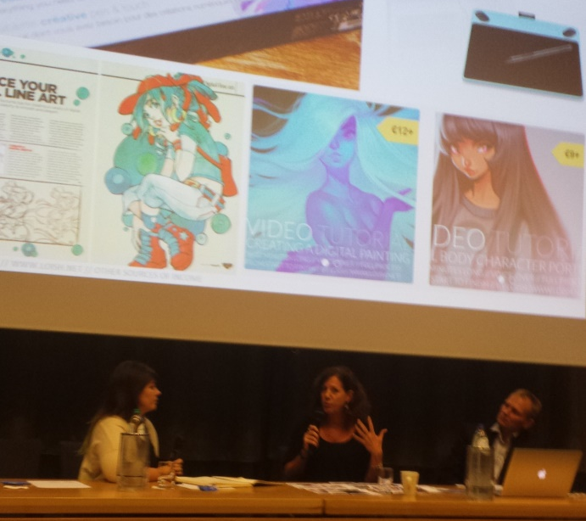

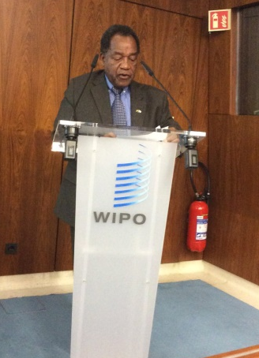
Representing authors at international events
The IAF holds events at and attends international meetings to:
Give a platform to local authors at international events
Promote authors’ rights
Put authors in contact with decision makers

Slide 5


Recent campaigns

Slide 6
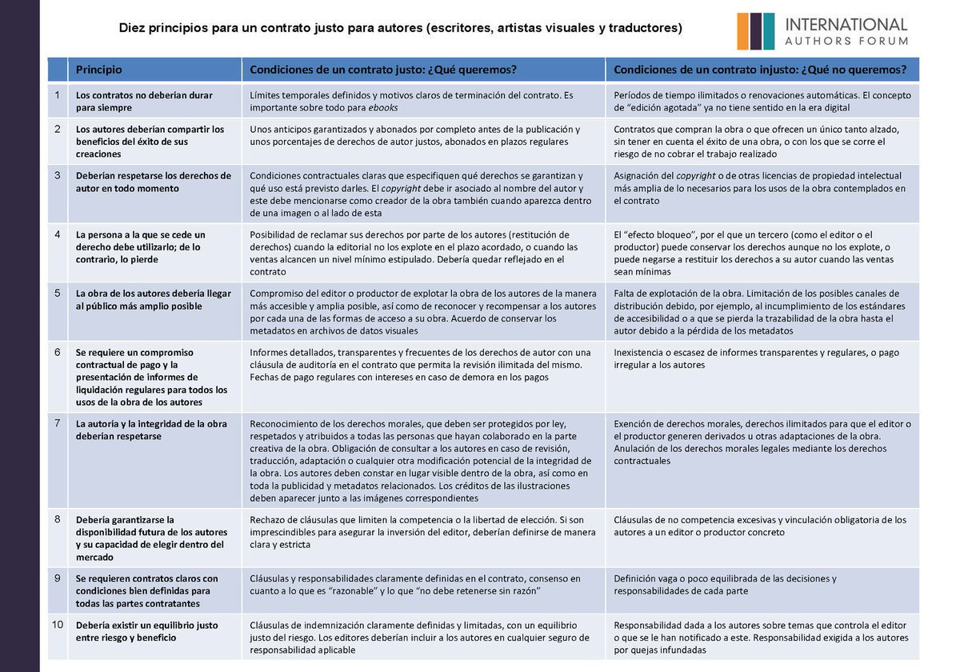
Recent campaigns

Slide 7
Thank you

